Slide 1
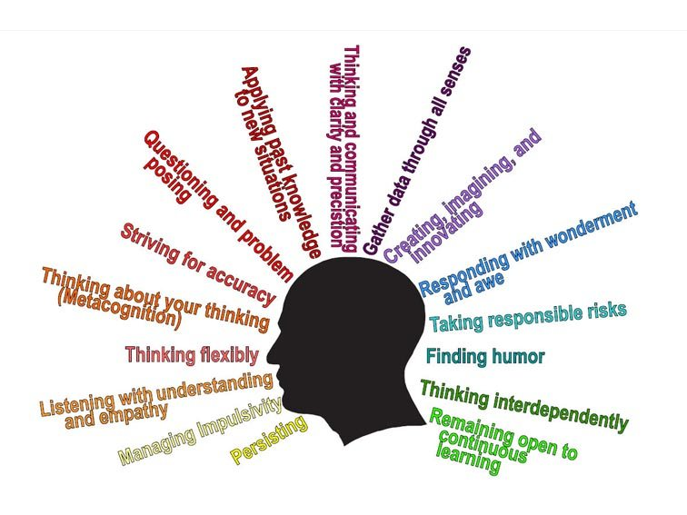
Habits of Mind

Slide 2
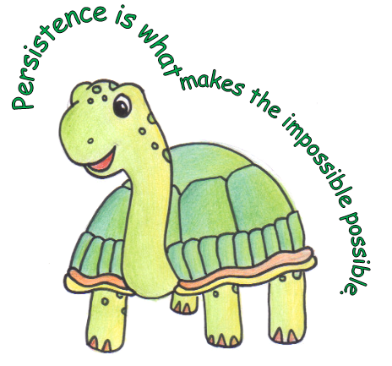
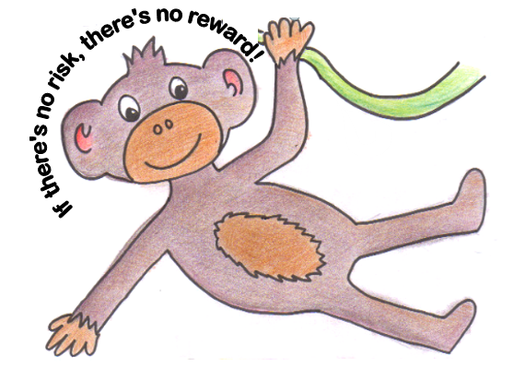
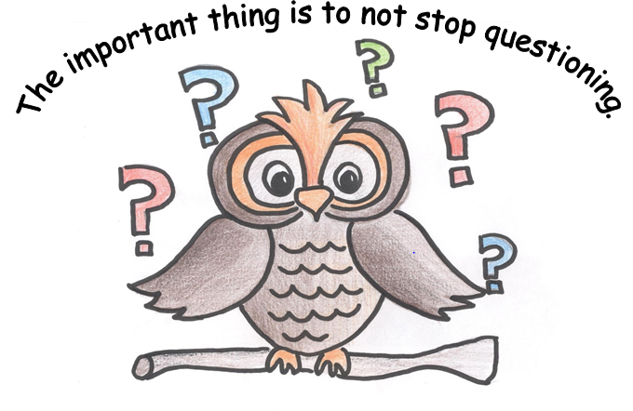
What habits have we learnt about so far?
Can you match up the logos with the habit? Why have we chosen these animals for each habit?

Slide 3
Thinking Interdependently
What is the definition of this Habit?
The ability to work, learn, think and act together.
To learn from others and appreciate different perspectives.
Understanding that many minds can be stronger than one.
Being able to make compromises for the greater good.
https://www.youtube.com/watch?v=ftXOZ05SGiM

Slide 4

Why does it matter?
We work with others everyday at school, in jobs and in our local communities. You will be interacting with different people who have a range of ideas, beliefs and values.

Slide 5

When should you use the Habit?
Whenever you have the opportunity to engage in a worthwhile activity or task as part of a group.

Slide 6
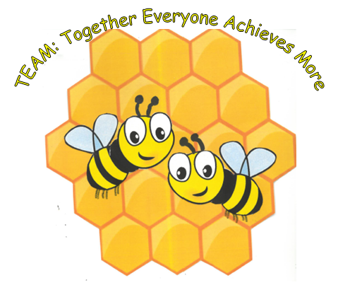
Logo for Thinking Interdependently
Notes:
A hive of bees is the logo for Thinking Interdependently as it is their instinct to work together as a group, each with distinctive roles.

Slide 7
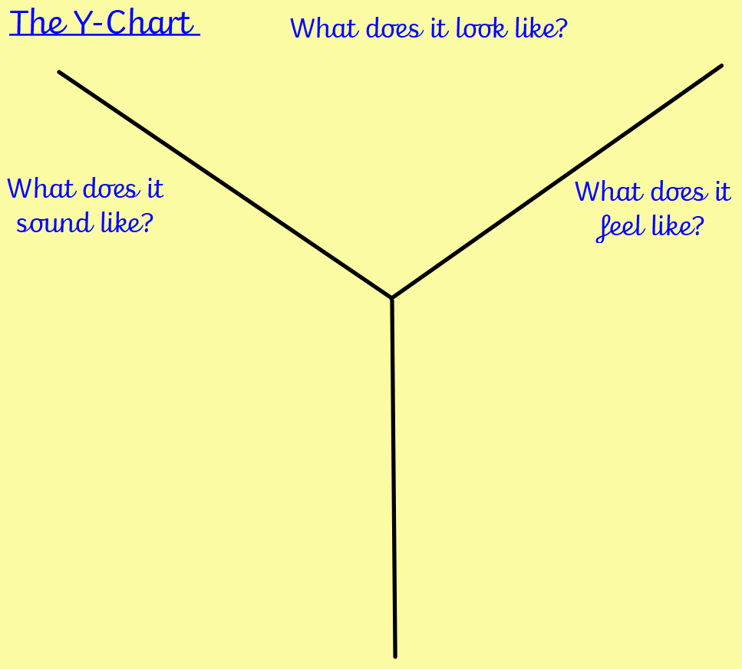
Notes:
For each HOM we use Y-Chart to consider how it will look/sound/ feel in the classroom/ make it a reality.
In groups draw and complete (10 mins)
Feedback (5 mins)

Slide 8
What it looks like?
People who:
Encourage each other.
Put others before themselves.
Feel happy when others do well and are recognised.
Check everyone is participating.
Listen
Aware of others who feel left out from the work.
When is a good time to think interdependently?

Slide 9
Group Roles
What roles shall we have in our class groups?
Leader
Challenger
Doer
Thinker
Supporter
You might be more than one role!
Notes:
You can edit these according to what you decide as a class. These are some examples from https://studyhubresources.fxplus.ac.uk/activities/team-roles

Slide 10
Group Roles
What does each role do?
1. LEADER: makes sure team has clear objectives and members are engaged
Leaders have good awareness about what skills their group needs to develop, they are good at planning and prioritising tasks needed to complete work. They are organised and focus on time management, and can set realistic targets. They have a good sense of when a problem is 'solved', and pay attention to detail in checking and finalising work.
2. CHALLENGER: questions effectiveness and drives for results
Challengers can look at problems and see more than one solution. They are able to explain ideas and counter-ideas clearly to people, and are always thinking about how to do things better.
3. DOER: encourages progress and takes on practical jobs
Doer's deal well with distractions are focused workers. They know where to go to find information and are proactive about doing so. They are focussed on the task and ask for help when they are stuck on a problem.
4. THINKER: produces ideas and thinks through those proposed by others
Thinkers are good at selecting the information they need to solve problems or complete tasks. They are logical and can break down tasks into steps and put information in order. When solutions to problems don't work they try to find out why and approach the problem from another direction.
5. SUPPORTER: eases tension and promotes harmony
Supporters work well with other people and listen to their suggestions. They like to check that they have understood problems, and suggest different ways of solving them in a team. They stay calm when there is disagreement or conflict. They can follow instructions to get tasks done and see how these contribute to overall team goals.

Slide 11

Questions to ask about your thinking:
Roles Are you helping the group move forwards? What role are you playing? What role is needed? Purpose What is the group's purpose? What goals are you working towards? Reflection What have we achieved? What have we learned? What is the next step? What problems did we face? Next steps Are you all agreeing too easily? Are we all sharing our ideas? Have we tested our ideas?

Slide 12
Let’s try these roles out…
Notes:
Each child in the group chooses a role

Slide 13
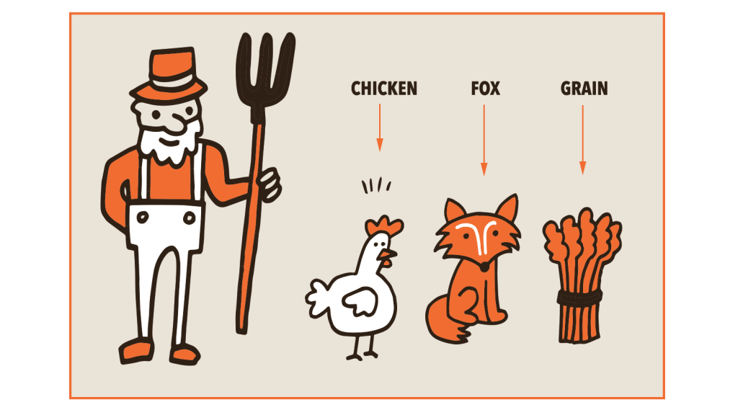
Problem solving team challenge
A man has to get a fox, a chicken, and a sack of grain across a river.
He has a rowboat, and it can only carry him and one other thing.
If the fox and the chicken are left together, the fox will eat the chicken.
If the chicken and the grain are left together, the chicken will eat the grain.
How does the man do it?
Notes:
Work in groups to solve (5-10 mins)
Feedback 5 mins
Recap of the roles and purpose halfway through

Slide 14
Questions to ask about your thinking:
Roles Are you helping the group move forwards? What role are you playing? What role is needed? Purpose What is the group's purpose? What goals are you working towards? Reflection What have we achieved? What have we learned? What is the next step? What problems did we face? Next steps Are you all agreeing too easily? Are we all sharing our ideas? Have we tested our ideas?

Slide 15
Questions to ask about your thinking:
Roles Are you helping the group move forwards? What role are you playing? What role is needed? Purpose What is the group's purpose? What goals are you working towards? Reflection What have we achieved? What have we learned? What is the next step? What problems did we face? Next steps Are you all agreeing too easily? Are we all sharing our ideas? Have we tested our ideas?

Slide 16
Problem solving team challenge
A man has to get a fox, a chicken, and a sack of grain across a river.
He has a rowboat, and it can only carry him and one other thing.
If the fox and the chicken are left together, the fox will eat the chicken.
If the chicken and the grain are left together, the chicken will eat the grain.
How does the man do it?
Notes:
Reflect on group work and give answer

Slide 17
Questions to ask about your thinking:
Roles Are you helping the group move forwards? What role are you playing? What role is needed? Purpose What is the group's purpose? What goals are you working towards? Reflection What have we achieved? What have we learned? What is the next step? What problems did we face? Next steps Are you all agreeing too easily? Are we all sharing our ideas? Have we tested our ideas?
Notes:
What are the next steps? Consider strategies to help on next slide

Slide 18


Top Strategies
Understanding the success of the group depends on everyone's participation.
Aim to listen more than you speak.
Understand your role within the group
Celebrate the different ideas and viewpoints
"I agree with you because......."
"I disagree with you because.............“
Consider what you want to achieve as a group.
Discuss what worked well and how it could be even better when working as a team.

Slide 19
Videos showing examples of teamwork
https://www.youtube.com/watch?v=fUXdrl9ch_Q&t=13s
https://www.youtube.com/watch?v=6fbE52YDEjU
How did the meerkats work together?

Slide 20
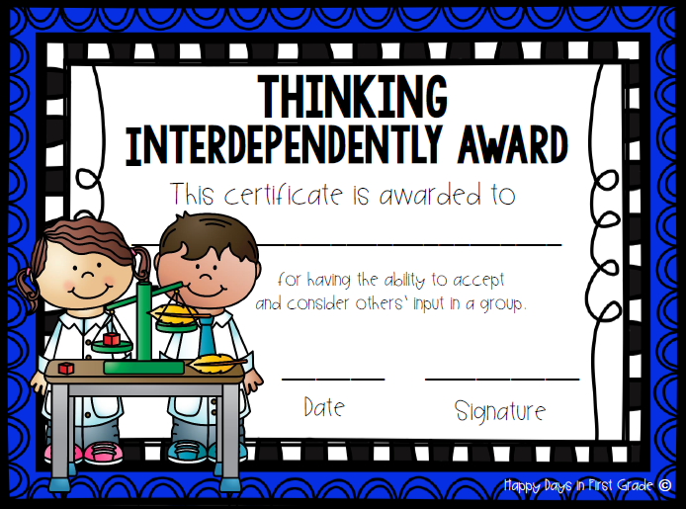
Notes:
Encourage children to earn this certificate during Celebration Assemblies

