Slide 1
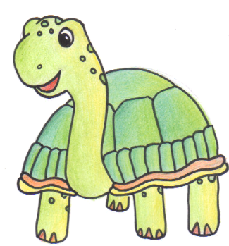
Persistence
Persistence is what
makes the impossible possible.

Slide 2

What is persistence?
It's when you keep trying even when you find something difficult.
Persevering in task through to completion; remaining focused.
Looking for ways to reach your goal when stuck.
Not giving up.

Slide 3
Can you think of any examples when you have persisted?

Slide 4
Examples…
Sportsmen and women:
David Beckman kept missing penalties. He kept practising and now he is an amazing footballer!
https://www.youtube.com/watch?v=Vq4wrPL1o4s&safe=active

Slide 5
Examples…
Singers:
Listen to Bruno’s message…
https://www.youtube.com/watch?v=pWp6kkz-pnQ&safe=active

Slide 6
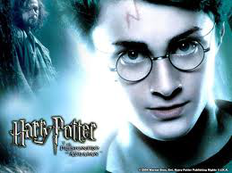
Examples…
Writers:
JK Rowling was turned down by multiple publishers for years. She persisted and now we have…

Slide 7
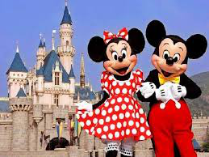
Examples…
Walt Disney had an idea to create a magical theme park. His idea was turned down 302 times!

Slide 8
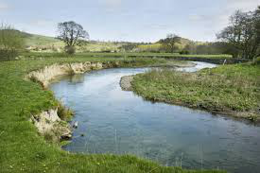
Examples…
A river cuts through a rock not because of its power but because of its persistence.

Slide 9
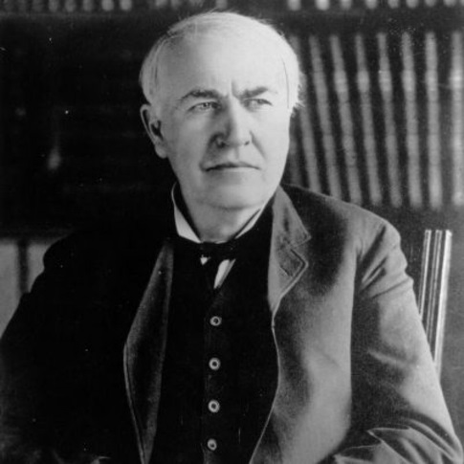
Examples…
Scientists:
Thomas Edison tried almost 10,000 times before he succeeded in creating the electric light. If he had given up, you would be reading this in the dark!
https://www.youtube.com/watch?v=VVL8ptff7yI&safe=active

Slide 10
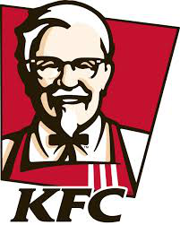
Examples…
Colonel Sanders went to more than 1,000 places trying to sell his chicken recipe before he found an interested buyer. The fact that we can buy Kentucky Fried Chicken today attests to his perseverance.

Slide 11
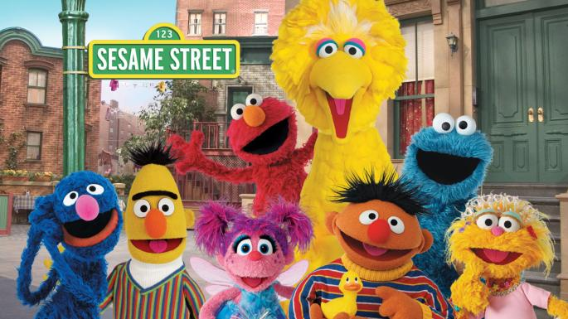
Persistence and Sesame Street
https://www.youtube.com/watch?v=fMeypGfS6Ys&safe=active

Slide 12
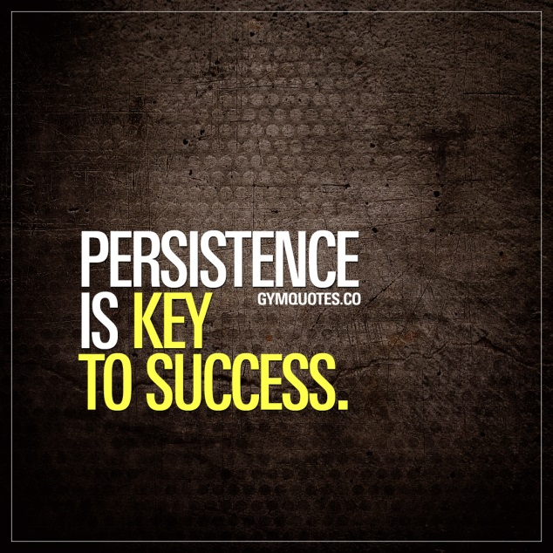
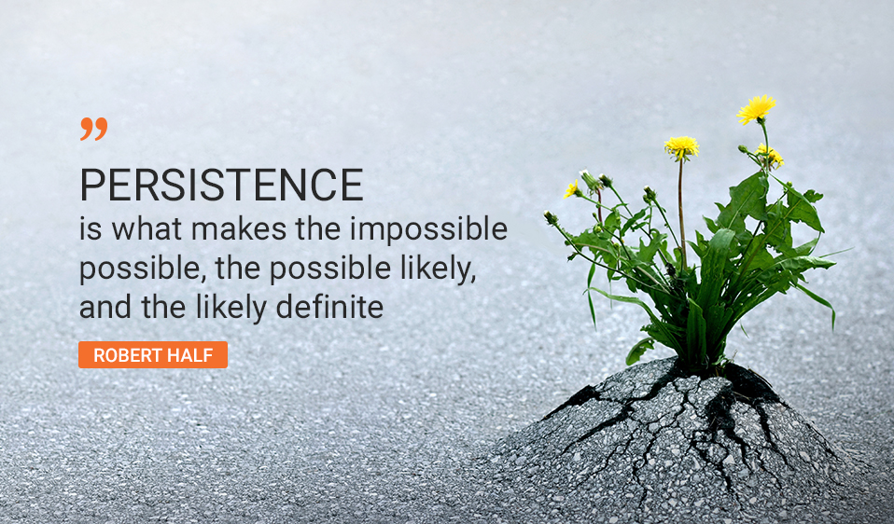
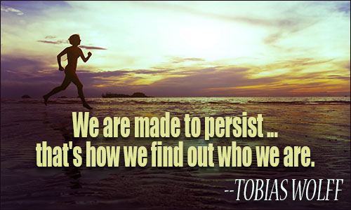
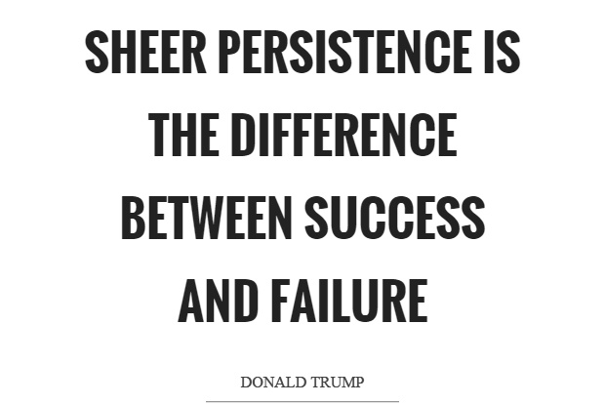
Famous quotes

Slide 13
Songs about persistence
https://www.youtube.com/watch?v=iiFKju-2UDc&safe=active
Don’t stop Believing – Glee
https://www.youtube.com/watch?v=UJ9BvW-j-ug&safe=active
The Script – Hall of Fame
https://www.youtube.com/watch?v=qolUC13bwMc
The Climb –Miley Cyrus
https://www.youtube.com/watch?v=PcKoYGNj0BU
Something inside so Strong – Labi Siffre
https://www.youtube.com/watch?v=D6raJluIg40&safe=active
Reach -S Club 7

Slide 14
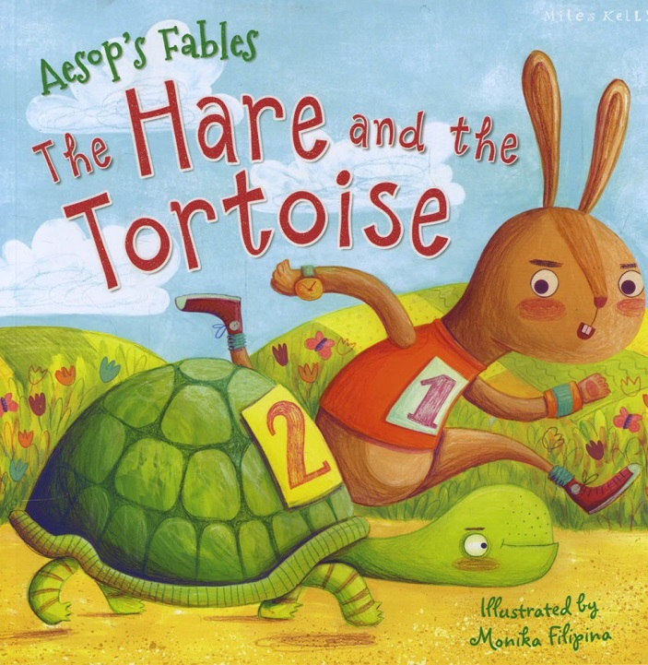

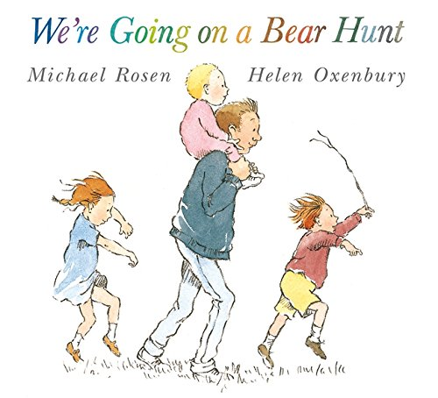
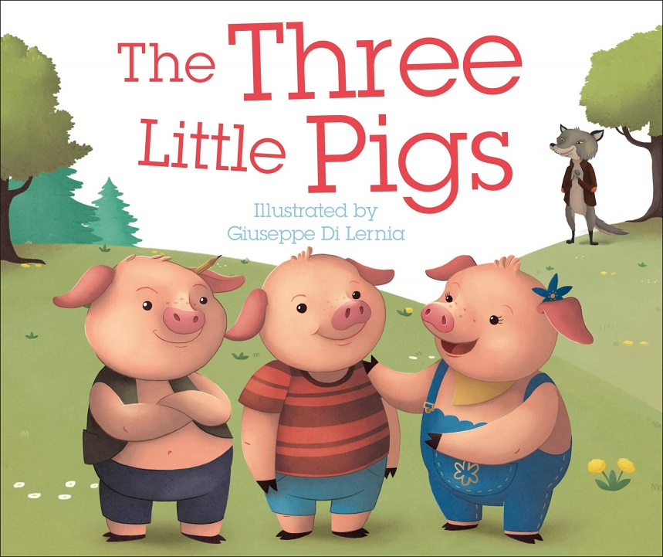
Stories about persistence

Slide 15
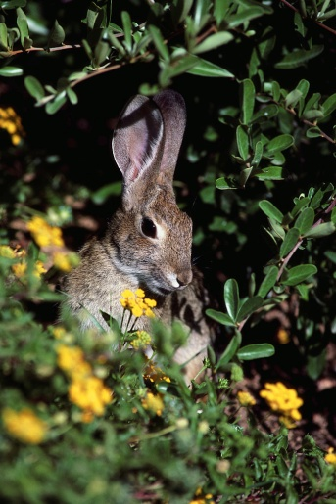
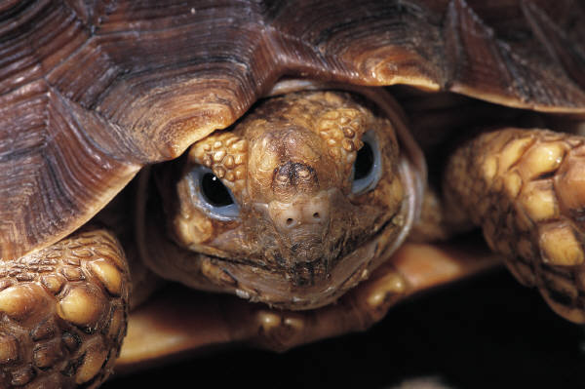
The Hare
and the Tortoise
https://www.youtube.com/watch?v=MeZe2qPLPh0

Slide 16
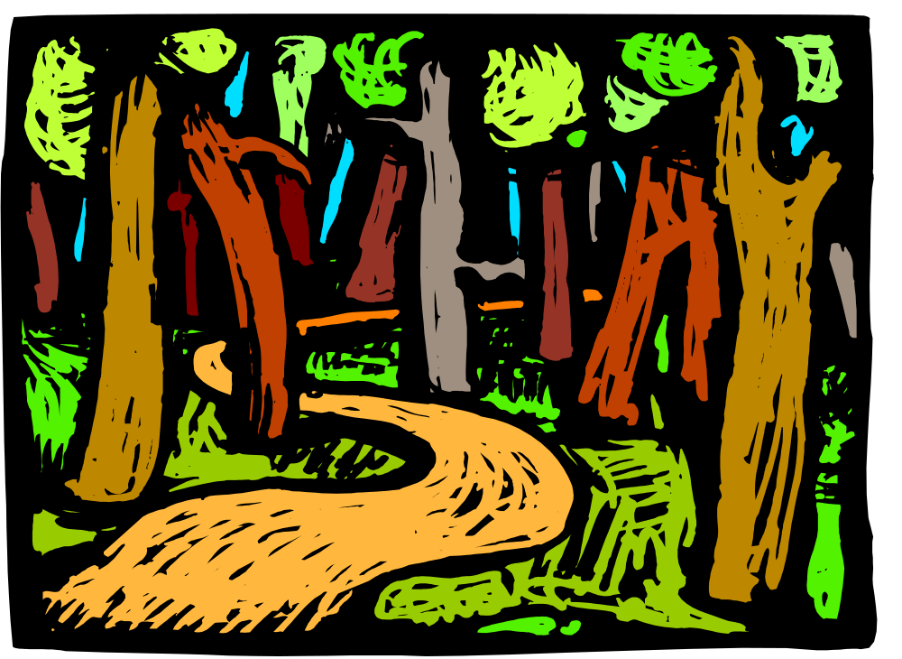
It was time once again for the Annual Woodland Race. All of the forest animals were very excited about competing in the race and winning the precious trophy. It was a great honour to win such an award so all kinds of animal had signed up to take part.

Slide 17

However, at the starting line of the race, many of the signed up animals changed their mind and decided not to race, and why? Well, it was Hare.
He had turned up to run the race but could not help himself in boasting to everyone else that he was the best at everything and that he was going to win.

Slide 18

Tortoise, however, stood firm on the starting line and waited to start the race, ignoring Hare.
“Huh!” grunted Hare, “I could beat you in my sleep. You’re so slow you could never win anything!”
But Tortoise remained still and ready.

Slide 19

The whistle blew and the two contestants set off, Hare went tearing ahead, leaving Tortoise moving very slowly and carefully through a big cloud of dust.
Hare had only been running for five minutes when he stopped and looked behind him. Tortoise was nowhere to be seen. “I can have a rest while I’m waiting for that lump to catch up with me!” he huffed and lay under a shady tree.

Slide 20
Hare dozed off in the cool of the trees and was in a deep, deep sleep when Tortoise came dawdling by slowly as can be.
He looked at the dreaming Hare and gave a quiet little chuckle. “Such a boaster,” he whispered to himself and kept wandering on by.

Slide 21

Some time later, Hare awoke. It was dusk! He had to hurry! He was still sure that Tortoise would be nowhere near the finish line.
He dusted himself down and set off at a sprint. What did he see as he neared the finish line?

Slide 22

Tortoise was just setting foot over that winning line and the other animals were cheering wildly as he slowly reached the trophy.
The moral of this fable is: slow and steady wins the race.

Slide 23
