Slide 1
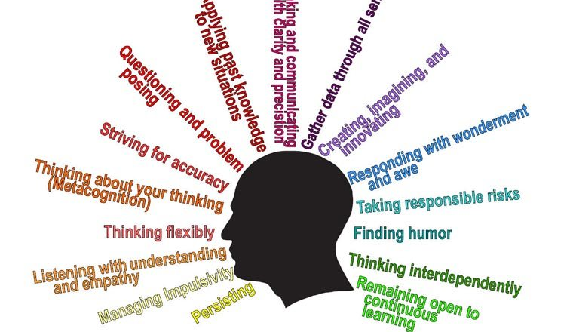
Habits of Mind

Slide 2


What are Habits of Mind?
They help us with problem solving.
They help us to be good learners.
They are good behaviours.

Slide 3





What makes us good learners?

Slide 4
How can Habits of Mind help us?

Slide 5


Questioning and Problem Posing

Slide 6
What does it mean?
It is not just asking questions but asking the right questions. Wanting to understand the why and how and what and when and where of things. Thinking about what information you will need to find to answer the questions and discovering ways to find it. Looking for problems to solve. Being sceptical especially when facts are presented without evidence.

Slide 7
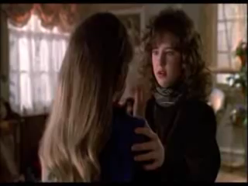

Slide 8

Why?
Asking questions is the beginning of all investigations.
Asking questions is what leads to great discoveries and makes the world a better place.
Asking questions is what helps you understand and not just know.

Slide 9

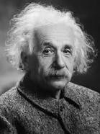
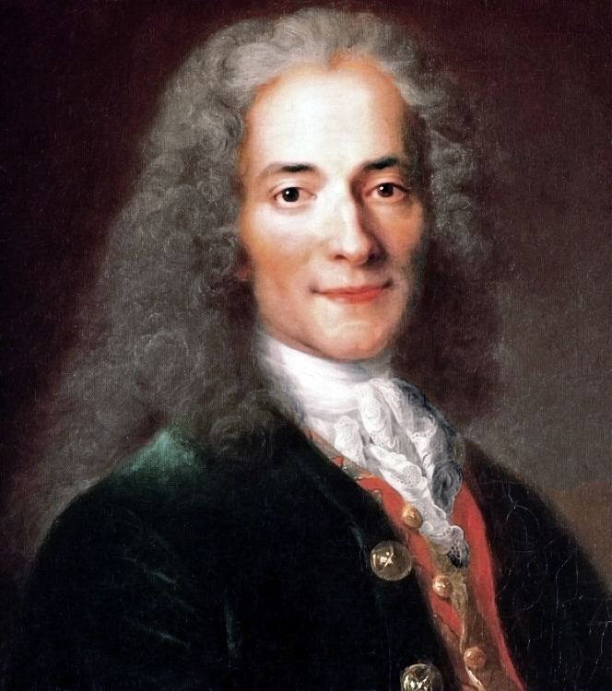
“The important thing is to not stop questioning.”
Albert Einstein
“Judge a man by his questions rather than by his answers.”
Voltaire
“Nothing shapes our journey through life so much as the questions we ask.”
Greg Levoy

Slide 10


Two famous people who pose questions and problem solve.
Tim Peake
Pope Francis

Slide 11


Slide 12

Thunks…
Unusual questions that make you think
Can you have a friend that you don’t really like?

