Slide 1
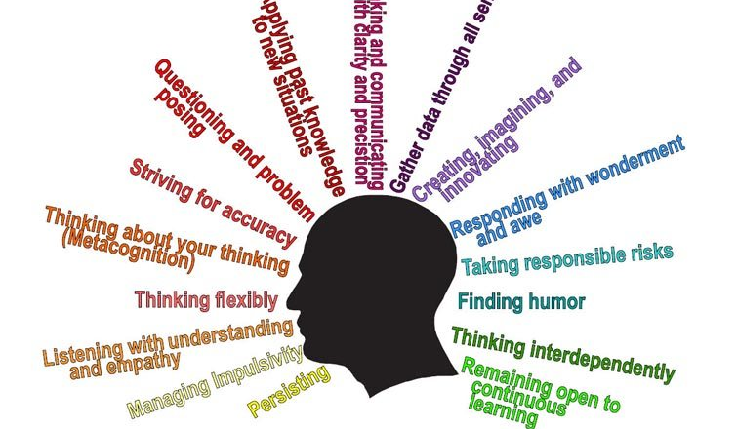
Habits of Mind

Slide 2
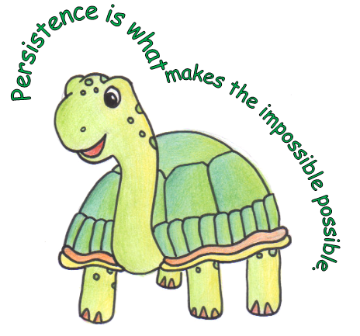

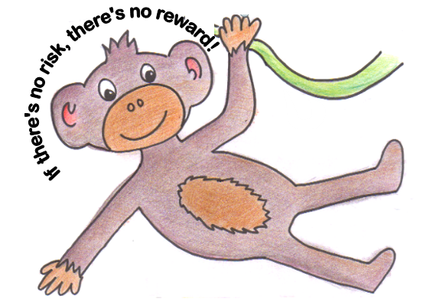
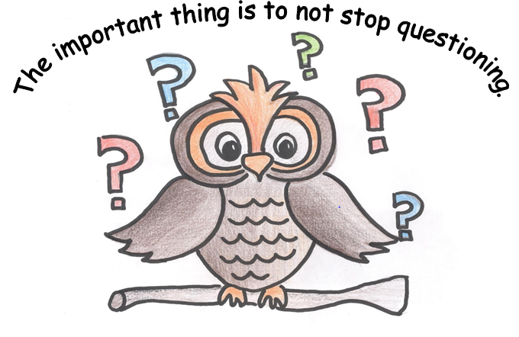
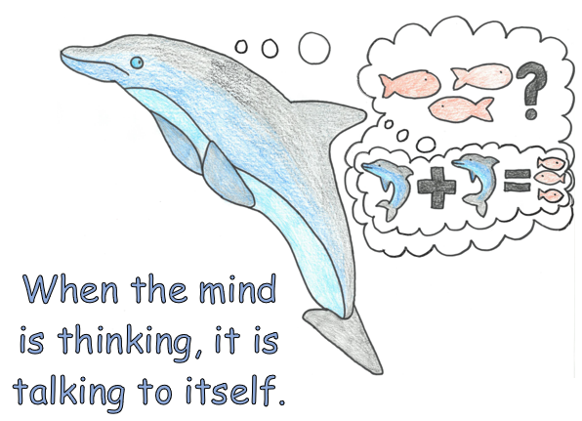
What habits do we have so far?

Slide 3

Striving for Accuracy
Helps in our school work
We can check in tests
We need to try to be as accurate as we can

Slide 4

Video to show Striving for Accuracy in action!
Notes:
https://www.youtube.com/watch?v=84VtdVK2a0A

Slide 5

What does it mean?
Avoiding mistakes, being precise.
Checking your work and editing with care.
Always presenting your best.
Checking your facts. Looking for sound evidence.
Making choices based on facts so not rushing to a decision.

Slide 6
When should we use it?
Whenever you need to present your best effort.
Checking calculations in Maths
When you are editing or improving your work
Scoring goals in sports
Completing tests or exams

Slide 7
Strategies to help
Check it twice, then check it again one step at a time.
Steps to success and key vocabulary
Classroom displays
Have a buddy check
Use resources to help you be accurate, e.g. rulers for straight lines, dictionaries for editing.
Check your facts are correct.
Try to get it right the first time and reward yourself when you do. Take the time you need to do it right, doing it over always takes longer

Slide 8
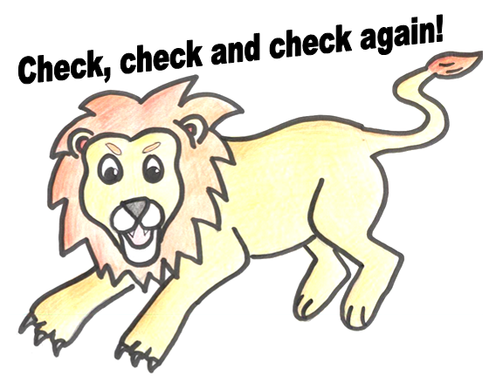
Logo for Striving for Accuracy

Slide 9
