Slide 1


Slide 2
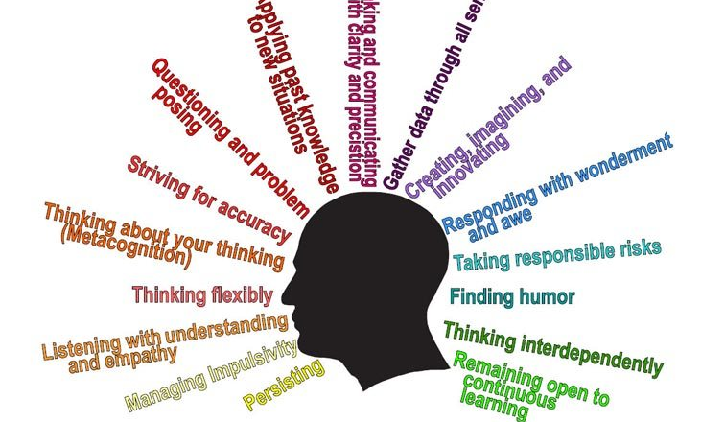
Habits of Mind

Slide 3


What are Habits of Mind?
They help us with problem solving.
They help us to be good learners.
They are good behaviours.

Slide 4
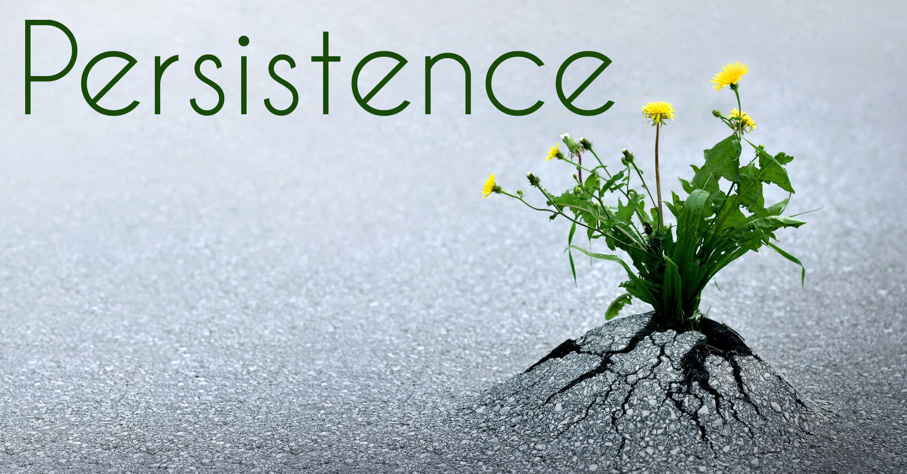




What makes us good learners?

Slide 5
How can Habits of Mind help us?

Slide 6
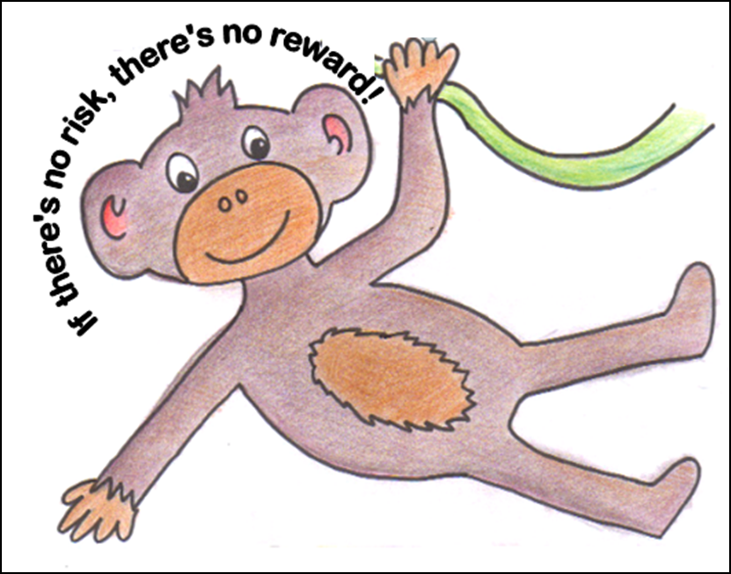
Taking Responsible Risks

Slide 7



Taking Responsible Risks

Slide 8
Taking Responsible Risks
Why is this word so important?
Not all risks are sensible choices. You must think first... Is this dangerous? Will I hurt myself or others? If the answer is yes, it is not a responsible risk.
Notes:
Everyone has things that they are good at and things they are not so good at. If we don't take the risk to try new things then we can never get better at them. A responsible risk might be sharing a new idea with your class or trying something you always thought was too hard for you.
Next time you find your work or an activity hard just give it a go. Take a risk and give it a try! We won't always get things right but at least you have tried!

Slide 9
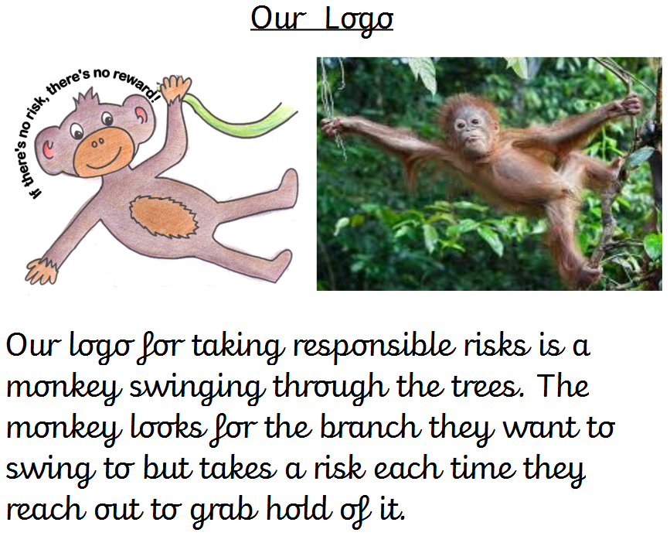

Slide 10
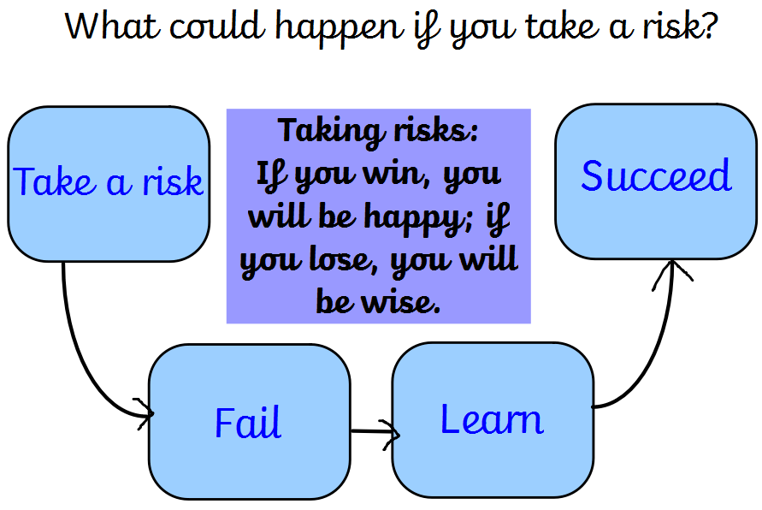

Slide 11

What strategies can you use to help you?
1 - Do a risk analysis
  What could go wrong?
  Can you minimise the risks?
  Are the benefits worth the risks?

Slide 12
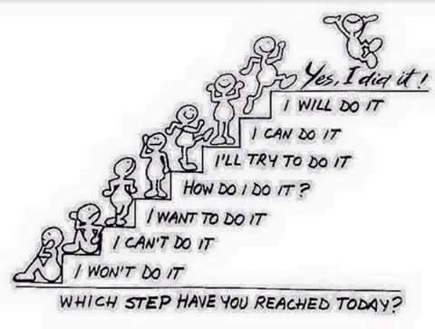
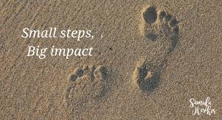
What strategies can you use to help you?
2 - Take one step at a time.
  You can take smaller steps to reach a bigger goal.

Slide 13
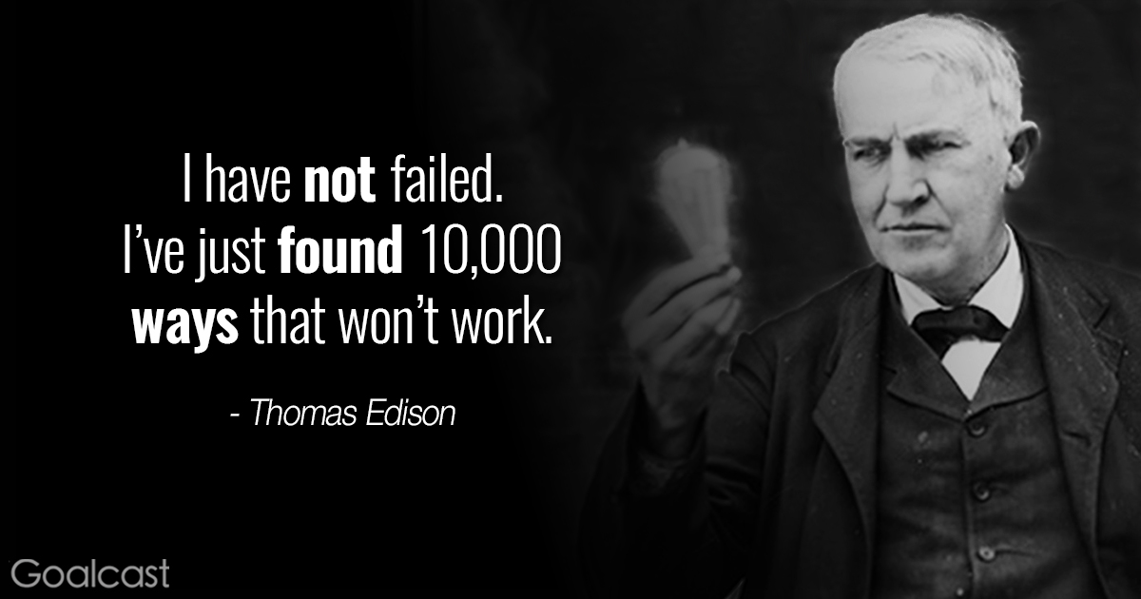
What strategies can you use to help you?
3 - Listen to the advice of experts, people who have done what you are trying to do.
  Look at a hero for inspiration.

Slide 14
Can you think of anyone who has taken a responsible risk?

Slide 15
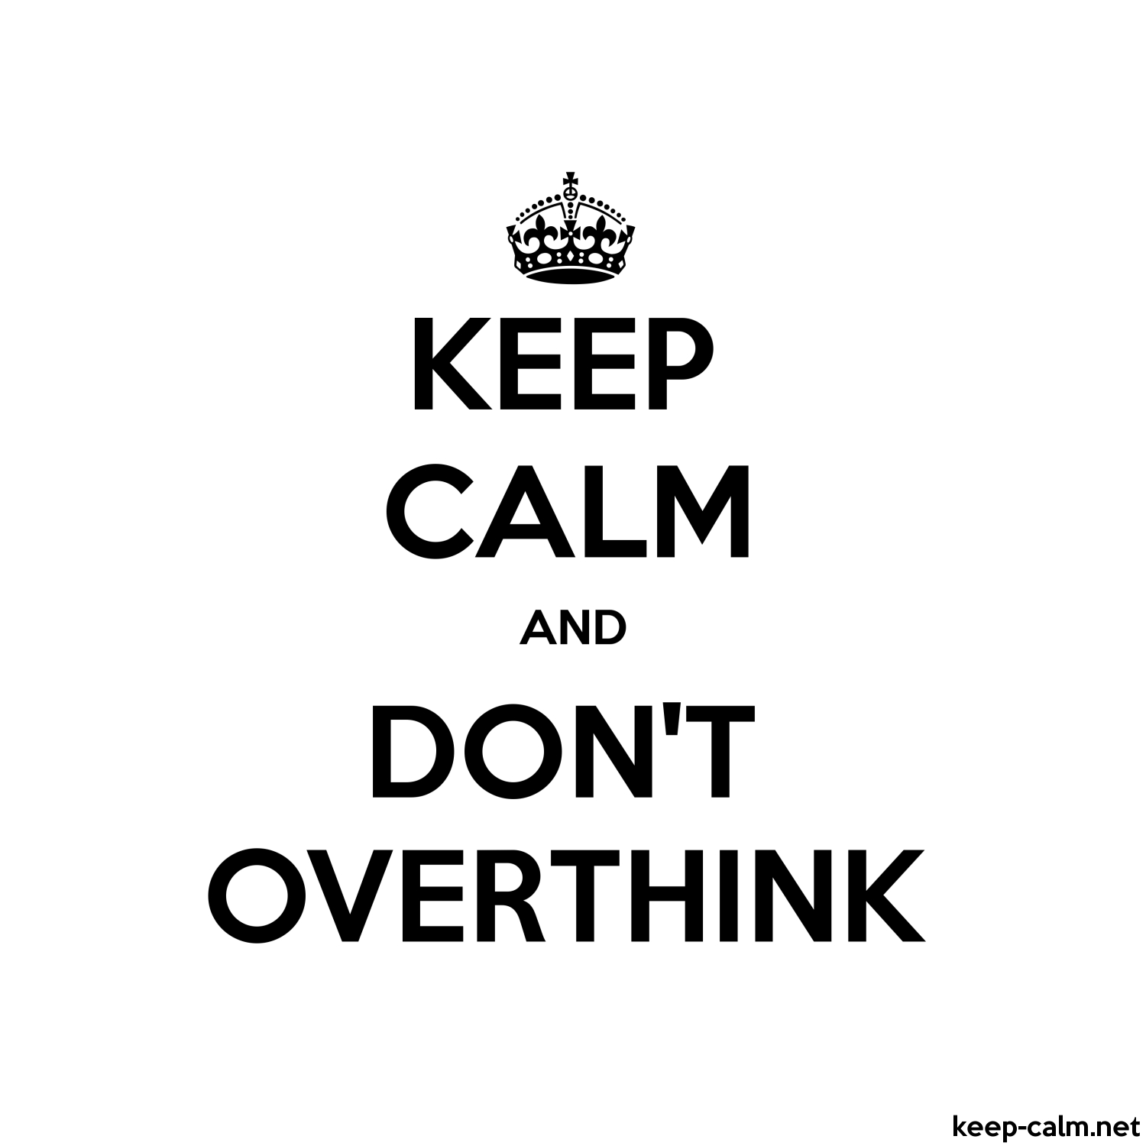
What strategies can you use to help you?
4 - Don't overthink, sometimes just doing it is the best remedy to overcome the nerves.

Slide 16
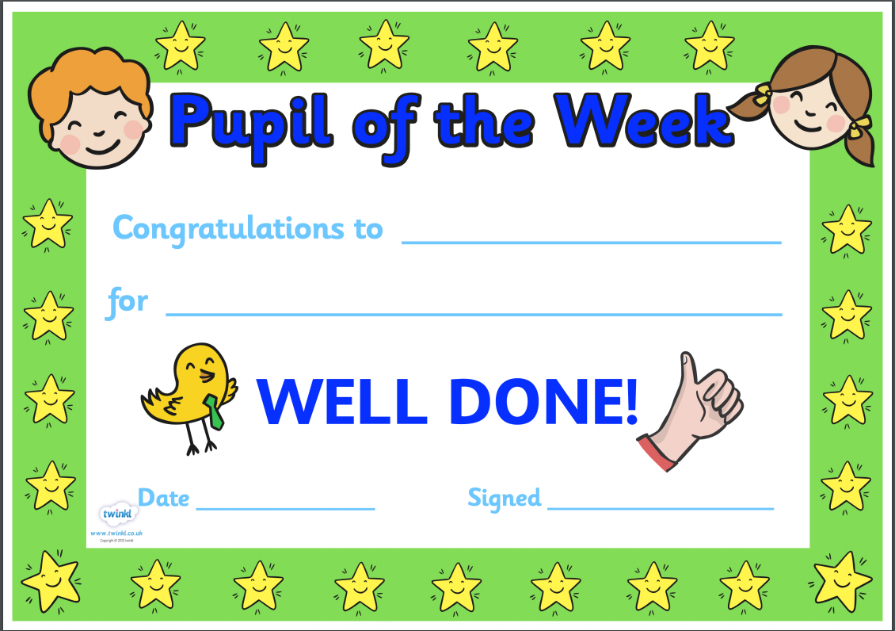

Slide 17
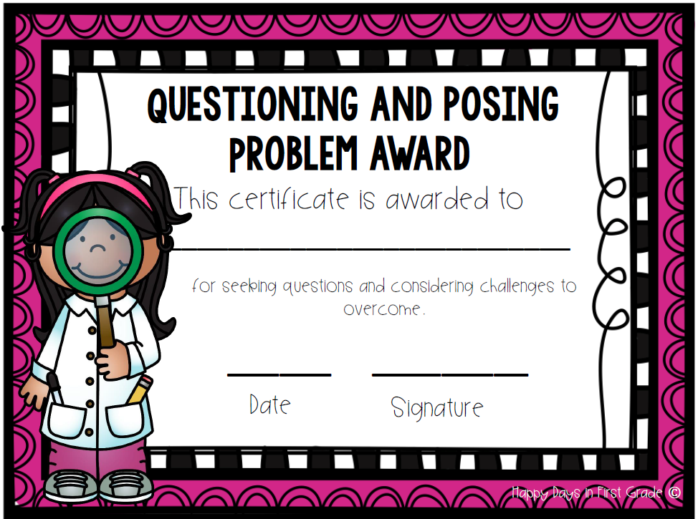
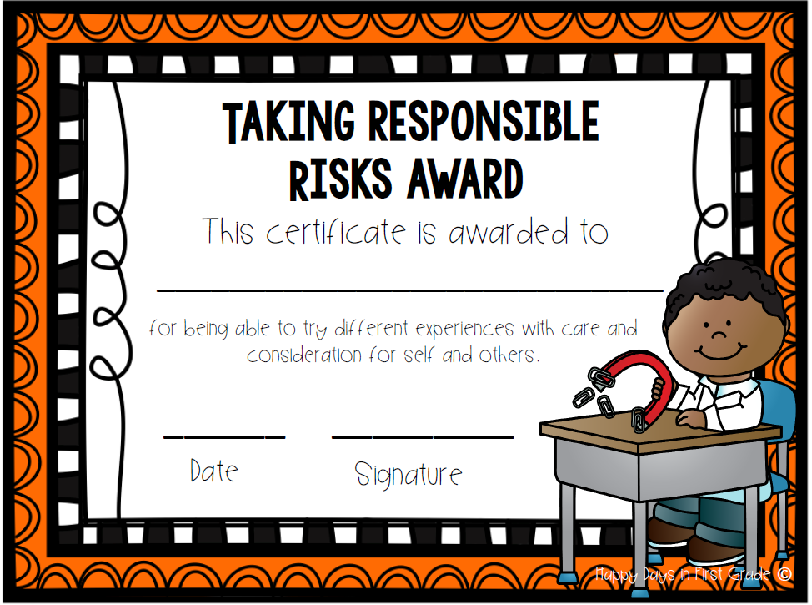
Habits of Mind Certificates

Slide 18


Slide 19




HOUSES

